Slide 1
Rethinking the Role of Decodable Texts in Early Literacy Instruction
Rick Chan Frey
University of California, Berkeley
rick@mustardseedbooks.org

Slide 2
Rethinking the Role of Decodable Texts
My focus: what kind of texts work best to help students learn to read—hard to study
On the way to answering this question, had to deal with decodable texts first and LTTM
Simple design, gather data on students reading actual, daily decodable texts and see what we find out
Analyzing this data became project on its own

Slide 3
Rethinking the Role of Decodable Texts
Theory of Word Learning
Ehri, 2005; Adams, 2009
See word in text
Attempt to decode it and do so successfully
Encounter the word again in text
Continue to decode it accurately
Decoding becomes more and more fluent until the word is recognized by sight

Slide 4
Rethinking the Role of Decodable Texts
Main Findings
Wide range in terms of successfulness in accuracy and fluency scores reading decodables
Struggling beginning readers had significant problems in terms of accuracy and fluency
These results are linked with the development of problematic reading behaviors

Slide 5
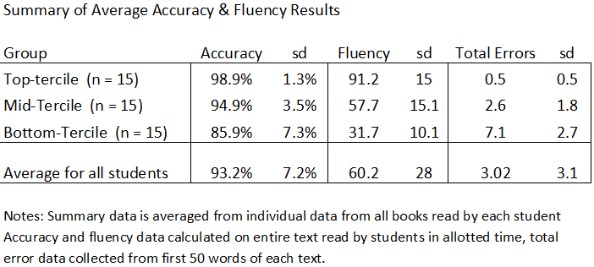
Rethinking the Role of Decodable Texts

Slide 6
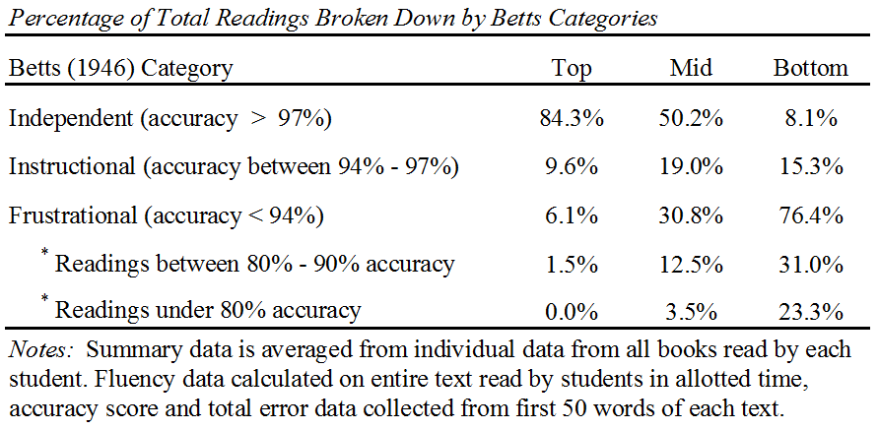
Rethinking the Role of Decodable Texts

Slide 7
Rethinking the Role of Decodable Texts
What’s the big deal about accuracy?
Adams (2009) great overview of the case for using decodables with beginning readers
Adams argues that successful repeated decoding is the “prepotent determinant” of automatic word recognition
So what happens when students make lots of mistakes?

Slide 8
Rethinking the Role of Decodable Texts
The relationship between accuracy
and word learning
Cunningham (2005) strong correlation between words read accurately and variety of word learning measures
Share (1999) mistakes during reading affect what is learned
Errors during reading undermines the development of automatic word recognition

Slide 9
Rethinking the Role of Decodable Texts
Where were students making errors?
84% of errors were on decodable words
13% of errors were on sight words
3% of errors on “story words”
Why isn’t the scaffold of decodability working?

Slide 10
Rethinking the Role of Decodable Texts
Should decodability support accuracy?
Hiebert, Stewart & Uzicanin (in press), study of student performance on DIBELS passages, word decodability did not predict accuracy
Compton, Appleton & Hosp (2004), 248 2nd grade students reading variety of texts, word decodability did not predict accuracy

Slide 11
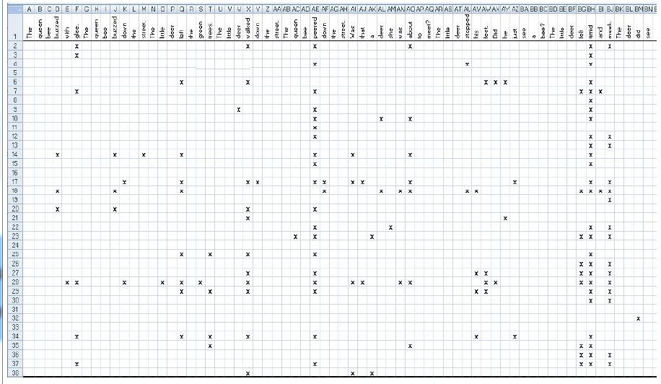
Rethinking the Role of Decodable Texts

Slide 12
Rethinking the Role of Decodable Texts

Slide 13
Rethinking the Role of Decodable Texts
Not all decodable words are created equal
25/45 students missed tramped
33/45 missed trudged
Of the 20 most frequently missed words, 19 are low frequency, longer, decodable words
Why include these words?
Intentionally unsupportive texts

Slide 14
Rethinking the Role of Decodable Texts
What happens when struggling readers spend all their time with texts that are too difficult?
Stop attempting to decode and ask to be told words they don’t recognize immediately
Tolerating gibberish
Inventing text

Slide 15
Rethinking the Role of Decodable Texts
The critical debate over supportive texts
Ehri & Roberts, 1979; Nation et al, 2007; Landi et al, 2006 – contextual support undermines orthographic learning
Texts that are too difficult lead to low accuracy scores which lead to reduced word learning outcomes (along with other problems)

Slide 16
Rethinking the Role of Decodable Texts
Alternatives to decodable texts
New and improved decodable texts
Fewer low frequency words
Strategic repetition
Supportive/natural language
Intelligently designed leveled texts www.mustardseedbooks.org

Slide 17
Rethinking the Role of Decodable Texts
For a copy of the paper or questions
Rick Chan Frey, Doctoral Candidate, Department of Education, UC Berkeley
rick@mustardseedbooks.org
www.mustardseedbooks.org

